Slide 1
Street Lighting and Road Safety The Royal Society for the Prevention of Accidents, May 2018
The latest evidence concluded that there was no evidence of an association between reduced lighting and nighttime collisions across England and Wales.
Surveys have shown that the public are in favor of street lighting as a way of improving road safety and that, if anything, it needs to be improved in some areas.
Misconception and bias among the public

Slide 2
BRIGHTER STREET LIGHTS CAUSE MORE ACCIDENTS Marchant P, et al. J Epidemiol Community Health 2020;0:1–6. doi:10.1136/jech-2019-212208
Brighter LED street lights don’t prevent accidents – in fact they may do more harm than good, according to a prominent statistician, who says the accepted science on street lighting is wrong.
No evidence was found for bright lamps leading to an improvement in road safety in any of the analyses. For this city, introducing brighter road lighting may have compromised safety rather than reducing harm.

Slide 3
The effect of reduced street lighting on road casualties and crime in England and Wales: controlled interrupted time series analysis
Steinbach R, et al. J Epidemiol Community Health 2015;69:1118–1124. doi:10.1136/jech-2015-206012
s This study found little evidence of harmful effects of switch off, part-night lighting, dimming, or changes to white light/LEDs on road collisions or crime in England and Wales
Despite using 14 years of data on road traffic collisions in 62 local authorities, we found no convincing evidence for associations between street lighting adaptations and road traffic collisions.

Slide 5
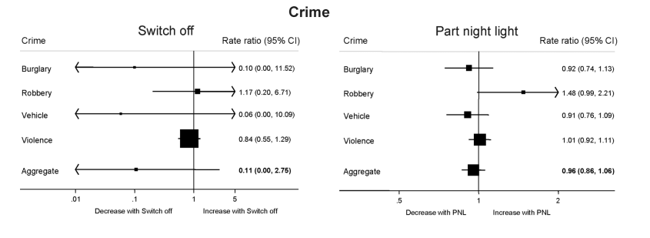

Slide 6
Panel Paper: Bright Lights, Safe Nights? the Effect of LED Street Lights on Crime in Los Angeles
November 9, 2018
Coolidge - Mezz Level (Marriott Wardman Park)
Anthony R Harding and Christopher Blackburn, Georgia Institute of Technology
Our preliminary results indicate the elasticity of property crime rates with respect to LED intensity is 0.1. So, a 1% increase in the intensity of LEDs corresponds to a 0.1% increase in property crime rates.
Chicago Alley lighting project: Final report
April, 2000
E Murrow, S Hutton, Research and Analysis Unit
Illinois Criminal justice Authority and University of Chicago

Slide 7
Myths of Outdoor Lighting
Myth: “Security Lighting reduces crime in urban outdoor areas.” : CALP
The “Chicago Alley Lighting Project” In multiple steps, the city:
“upgraded & improved” the city’s 175,000 streetlights, which illuminate the arterial & residential streets.
repaired & upgraded the lighting in & around viaducts and in Chicago Transit Authority stations.
boosted lighting levels in alleys across the city.
The plan increased the alley lighting from 90 Watt bulbs to 250 Watts.
The intent of the program was to increase feelings of safety and decrease crime in the alleys.
http://www.icjia.state.il.us/public/pdf/ResearchReports/Chicago%20Alley%20Lighting%20Project.pdf

Slide 8
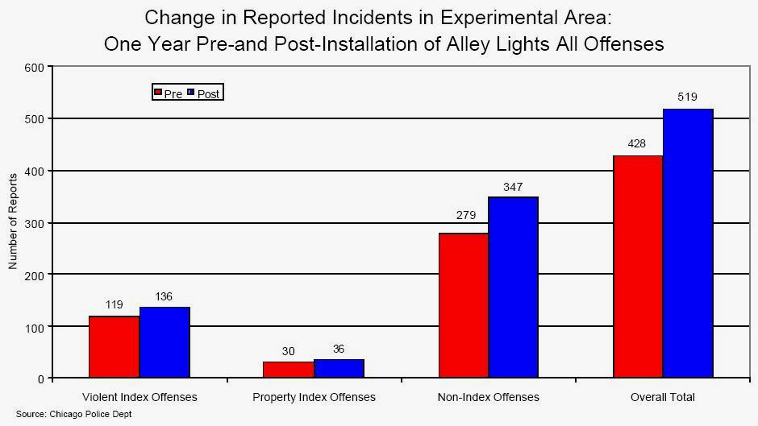
Myths of Outdoor Lighting
Myth: “Security Lighting reduces crime in urban outdoor areas.” : CALP
+14% +16% +24% +21%
Notes:
All forms of crime increased in the experimental area, but the Non-Index offenses had the greatest increase. 14% 16% 24% net 21% increases
http://www.icjia.state.il.us/public/pdf/ResearchReports/Chicago%20Alley%20Lighting%20Project.pdf

Slide 9
Street lighting may enable rather than hinder street crime 30 March 2022 Absence of street lighting may prevent vehicle crime, but spatial and temporal displacement remains a concern in Journal of Quantitative Criminology
Dr Edwards continued: “We didn’t set out to find the reasons for the observed changes, but it is possible that when lighting is switched off after midnight, offenders consider that the costs of committing a crime, such as using a torch, would likely raise suspicion among residents and risk being witnessed, outweigh the benefits.
“When lighting is switched off after midnight the streets are likely to be in near darkness, which means that any would-be offenders may find it challenging to see if there are any valuable goods left unsecured in vehicles, so offenders may choose to move elsewhere to fulfil their intentions.”

